Slide 1

The Office of the Public Guardian protects the rights and interests of adults who cannot make decisions for themselves, and young people and children in care.
For young people and children, they play an oversight role and advocate for them by:
developing a trusting and supportive relationship, so far as is possible,
obtaining their views, wishes and preferences,
ensuring their voices are heard,
assisting them to understand care, resolve disputes, and make complaints,
ensuring they are involved in making decisions that affect their care,
working with service providers to promote and protect their interests.
OPG does this through:
Community Visitors (CVs) and
Child Advocate Legal Officers (CALOs).
Who is the Office of the Public Guardian?

Slide 2
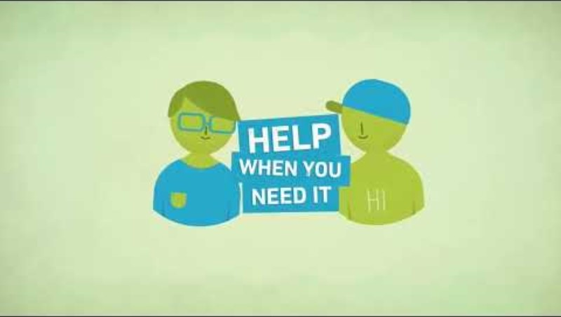

How can a Community Visitor help children and young people?
The functions of a Community Visitor are set out under section 13 and section 56 of the Public Guardian Act 2014 (PGA).
When visiting a visitable home, a Community Visitor may do any of the following:
look around the home and assess its appropriateness for the accommodation of the child under care.
have access to the child under care and talk with the child out of the hearing of other persons at the home.
require a carer staying at the home to give the visitor reasonable help to exercise the visitor’s powers. A person must comply with any such requirement (e.g. a requirement to provide a space to speak with the child/young person in private).
A child or young person living in a visitable site can communicate with a Community Visitor by phone, SMS message or email and they can also request a visit anytime.
Community Visitor Factsheet →

Slide 3
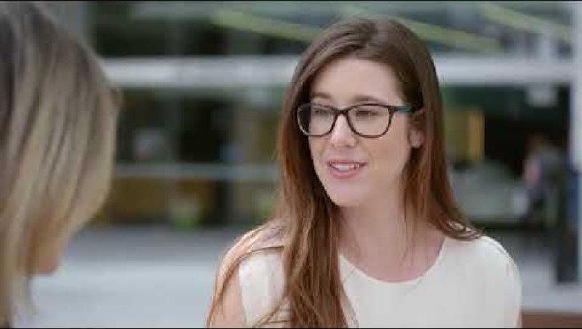
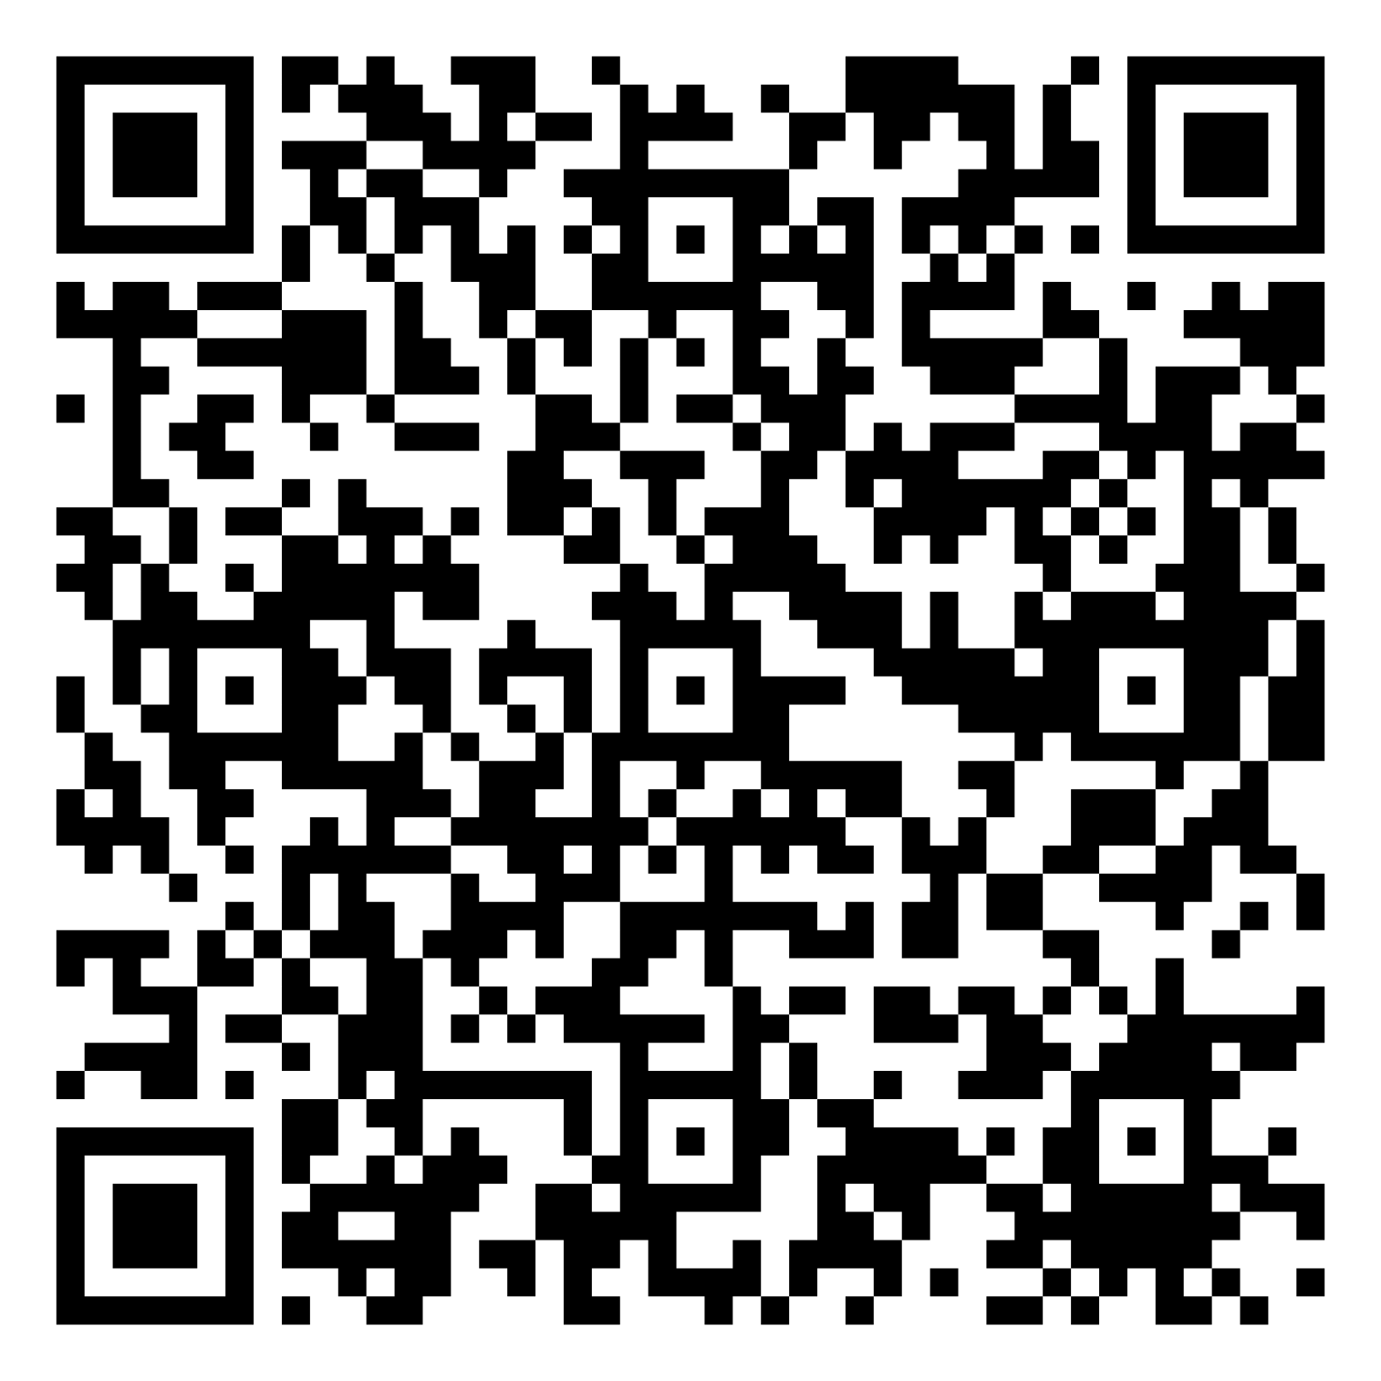
A Child Advocate will provide individual advocacy for a child or young person. The functions of a Child Advocate are set out under section 13 of the Public Guardian Act 2014 (PGA).
Child Advocates are different from Community Visitors. The main difference is that Child Advocates support young people with legal matters or issues.
A Child Advocate can only provide advocacy to children and young people who fit the definition of a ‘relevant child’ under section 52 of the PGA – in summary this means the young person or child and their family must have some involvement from Child Safety (e.g. Care Agreement, interim court orders).
Priority legal areas: child protection proceedings, education advocacy, youth justice advocacy and QCAT matters.
Child Advocate Referral Form - Anyone can make a referral for a Child Advocate including foster or kinship carers of a child in care.
How can a Child Advocate help children and young people?
Child Advocate Factsheet →

Slide 4

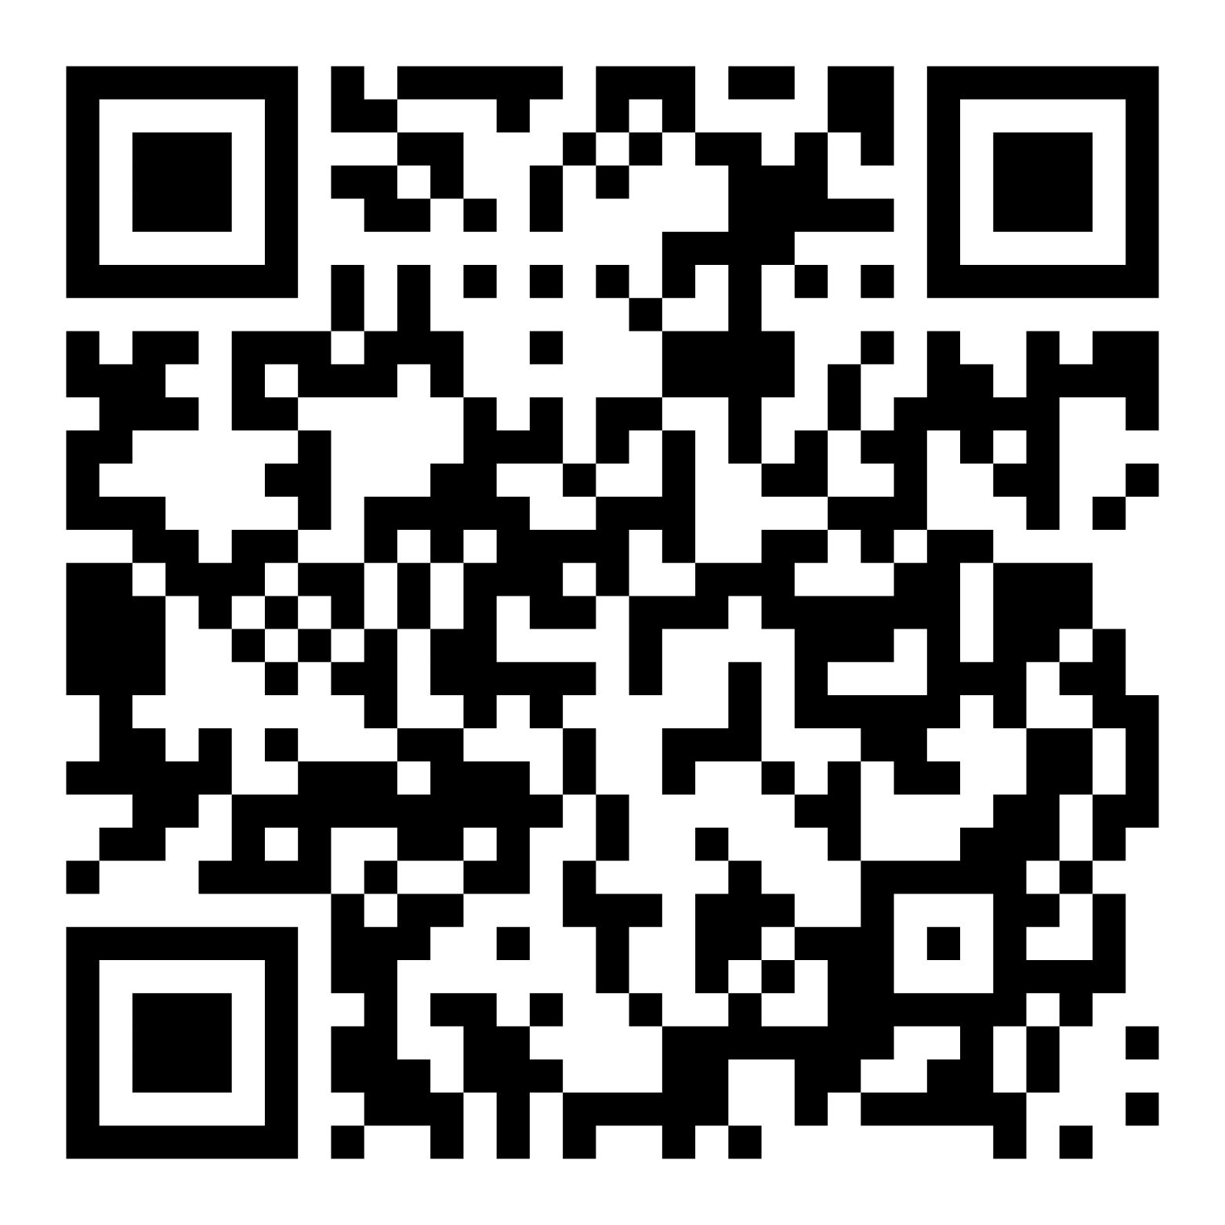
Webinar: Understanding your role with OPG as a foster or kinship carer
Please scan the QR code below and save the video (webinar) to watch later (approx. 37 mins).

